Slide 1


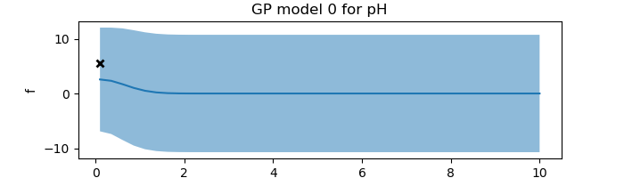
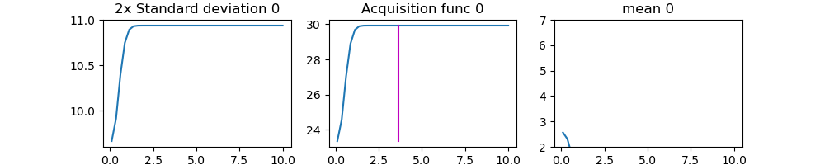
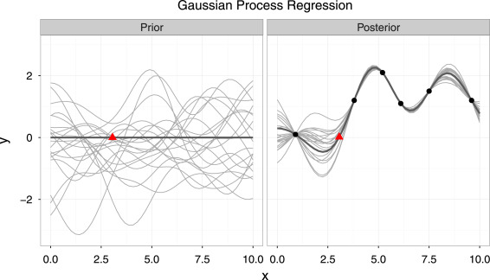
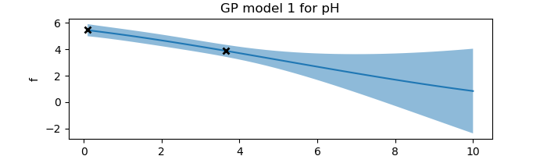
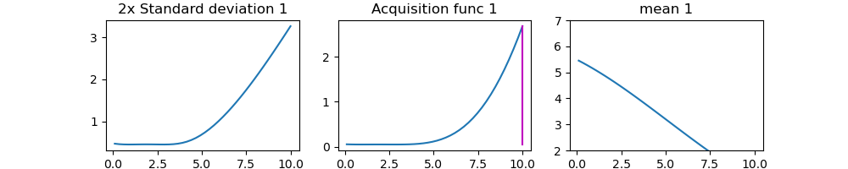
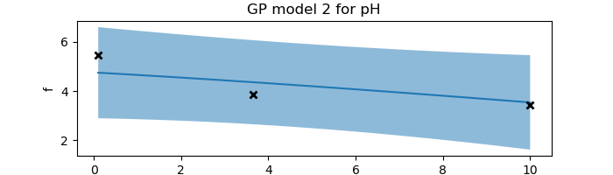
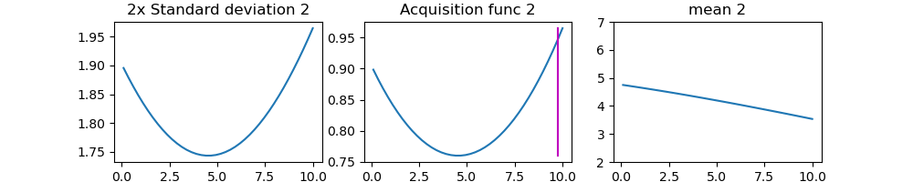
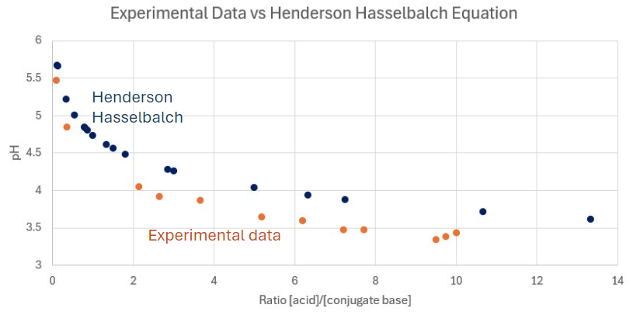
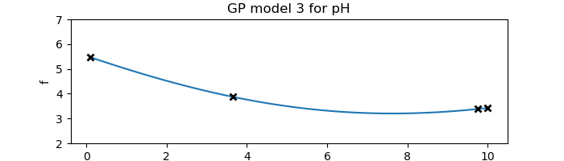
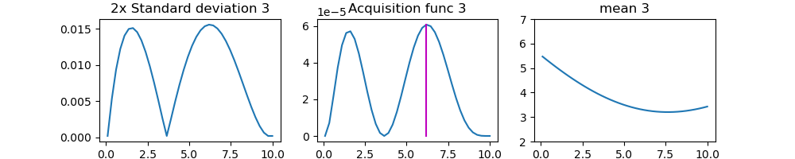
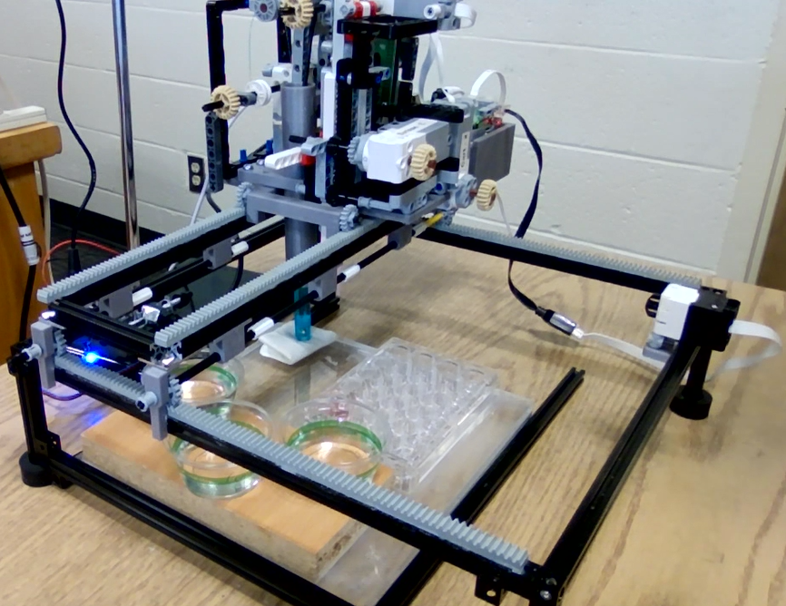
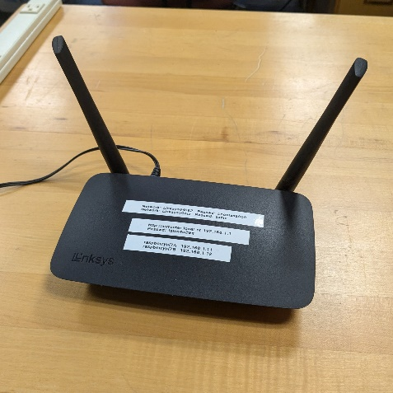
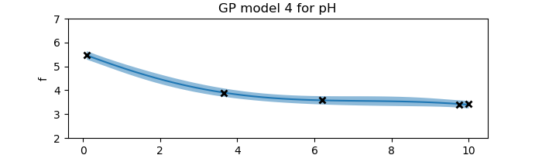
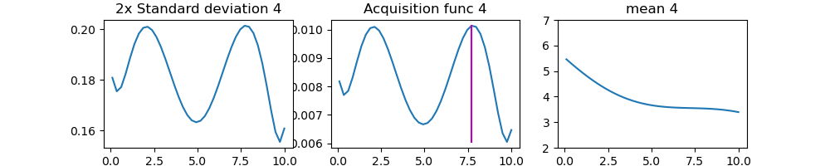
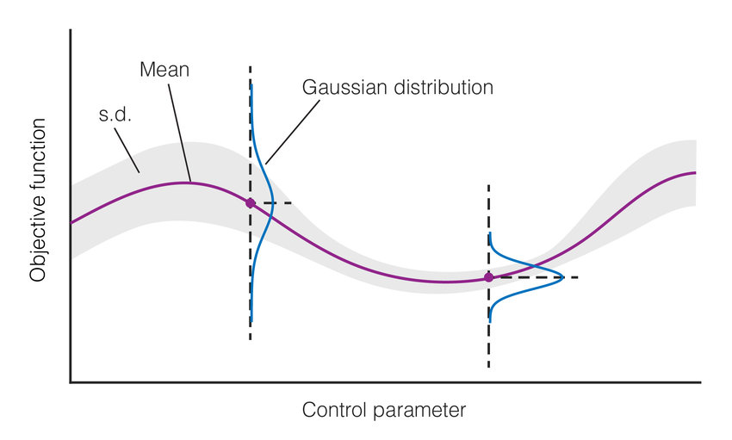
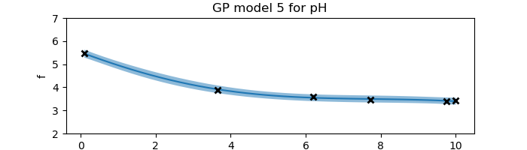
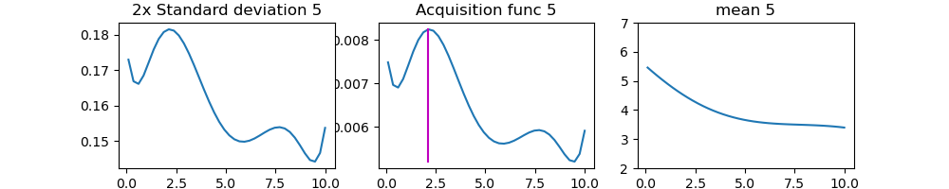
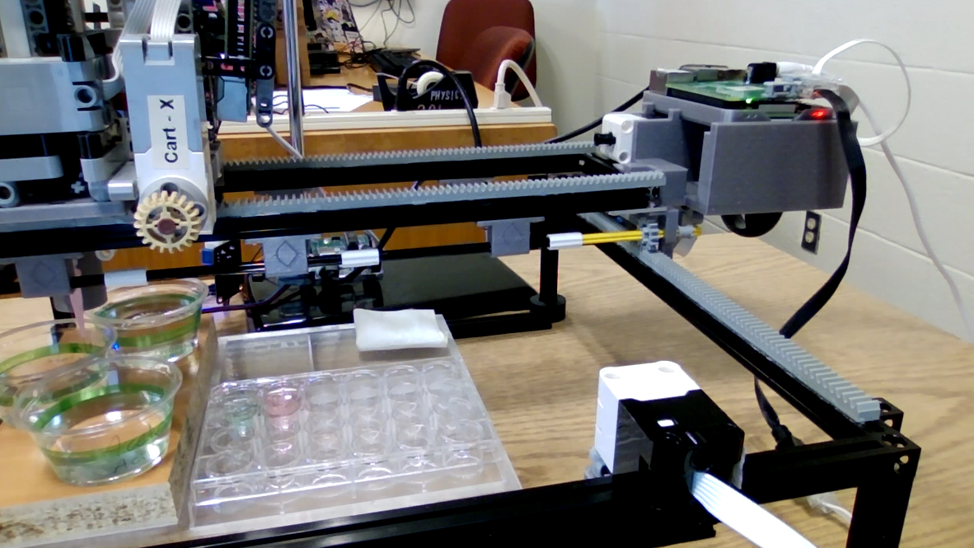
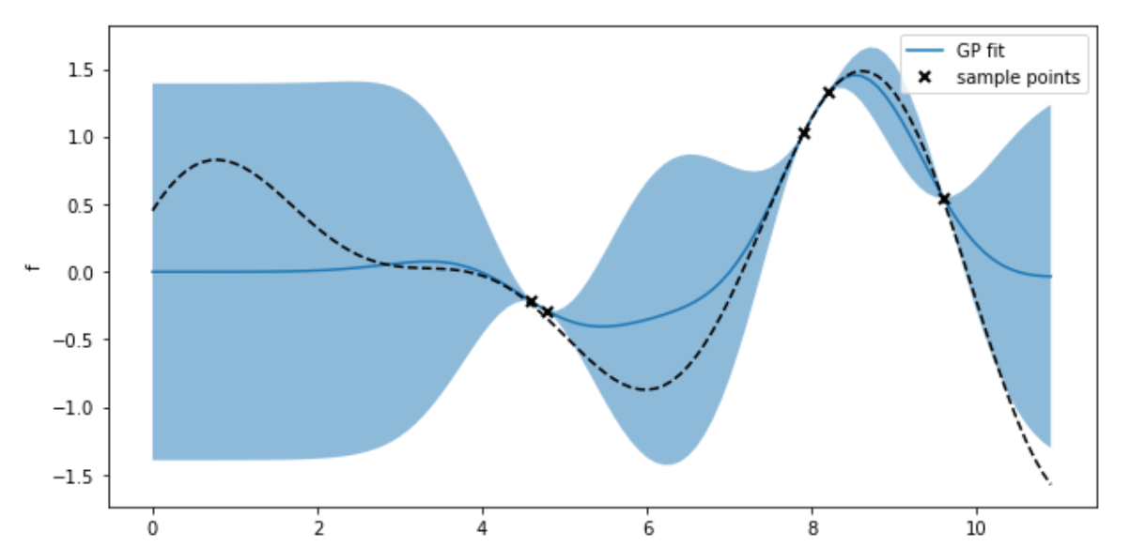
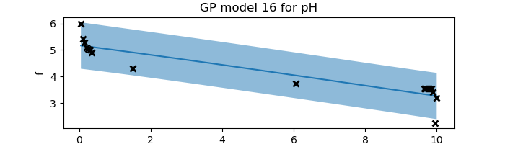
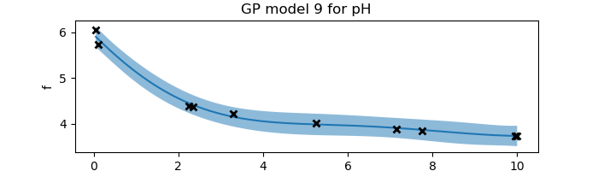
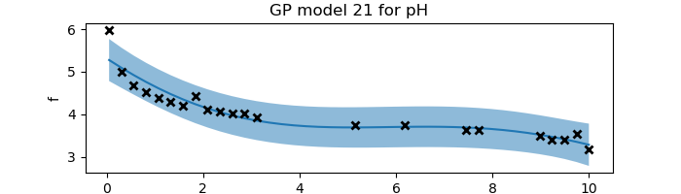
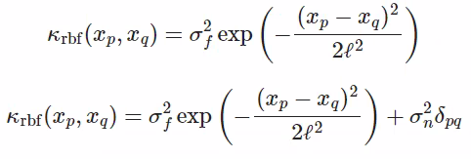
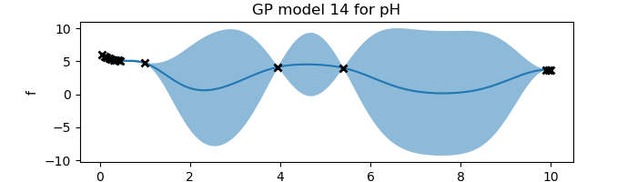
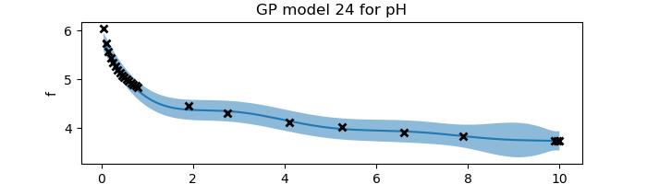
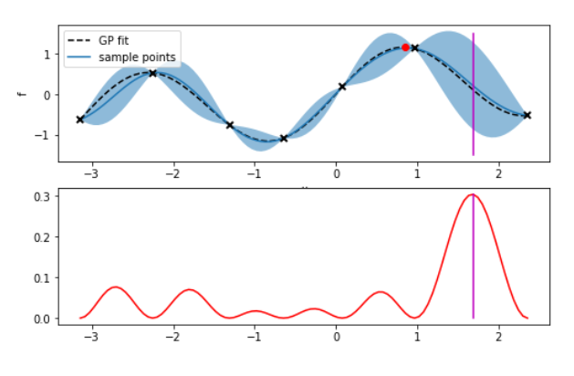
Automation and Machine Learning: How a Robot Can Conduct Its Own Experiments Using Gaussian Processes
Miller Gruen and Adi Timin
Advisor: Dr Mary Lowe, Physics Department, Loyola University Maryland
Introduction
Experimental Results: “Exploration”
When scientists need to take large amounts of data, rather than taking countless measurements that take time, resources, and money, it may be better to automate the task. Beyond that, what if a device were able to do more than simply repeat a task, what if it could make its own decisions and conduct an experiment wholly without needing constant human supervision? We can accomplish this using Gaussian processes applied to machine learning. LEGOLAS is a device capable of applying these principals to measure the pH of an acid and a conjugate base when mixed. This experiment may be more akin to a proof of concept, however this principal is extremely valuable and can be applied to countless other disciplines.
Goal to understand machine learning
Look at exploration, combine with exploitation
Explored experimentally and computationally
Our goal is to discover the shape of the curve of the pH that results when mixing together an acid and a conjugate base.
We used Acetic Acid and Sodium Acetate.
We begin by taking a measurement at 0.1 ratio of the [acid]/[conjugate base].
From that, we obtain a measurement. With it, we obtain a curve with the uncertainty required to create an acquisition function.
From this, we obtain the next data point.
This continues until the curve is found.
argmax = … this is for the acquisition function
Theory and Background
Apparatus
Gaussian processes is a method of doing regression. It shows which functions are most likely to describe the data being observed at any time during an experiment. When there is no data, the prior model has endless possibilities. Then as data is observed more and more, the true form of the underlying function becomes clearer. This regression method is non-parametric, which means there isn’t an equation that describes the function being fitted, just a curve - a set of points.
Legolas possesses:
2 Raspberry Pis and build hats to control motors
5 Lego Motors
1 Arduino and 1 pH sensor
1 pipette with a plunger
The Raspberry Pis connect wirelessly to a computer running the code and run the Lego motors using a build hat to connect.
Figure 1
In essence, a Gaussian process is a collection of normally distributed random variables. Thus, for each value of the control parameter, there is a Gaussian probability distribution (a.k.a. a Bell curve) as an output. The variance in the distributions showcases the uncertainty in the function. Where we have a better idea of the underlying function, the distributions are narrower. This plotted variance includes both the uncertainty in the model due to the lack of data (epistemic uncertainty), and the noise and fluctuations in the data itself (aleatoric uncertainty). The uncertainty is plotted on Figure 3 as the light-blue region (2 standard deviations). The darker-blue line on this graph is the mean of the function, what is called the surrogate function. It is the curve that most likely represents the true curve. The underlying curve that we desire to find the shape of is plotted with the black dotted line. The way to find out the shape of the surrogate function is by using a ”kernel” (covariance function). For any two given inputs, it shows how similar
Lego motor
Computational & Experimental Results: New acquisition function
Figure 2
Water
(rinsing)
We decided that this topic can be researched in more depth by not constraining ourselves to the apparatus that makes running even a single trial a lengthy process, limiting the number of trials we can do in a given time period and making it difficult to get instant feedback on any changes made to the code. We started generating data artificially to side-step the physical data collection process. It was generated based on the Henderson-Hasselbach equation, and eventually we were able to also add noise to the generated data to try to imitate
Raspberry Pi and Build Hat
Base
Limit switch
Acid
the behavior of the device. This computational work was also a way for us to explore Gaussian processes and experiment with different aspects of it, such as adjusting the hyperparameters, changing the kernel, adjusting the acquisition function, or changing the number of data points that can be taken during a trial.
Figure 3
Standards
Experimental wells
Written in python
Jupyter
Gp calculations done on computer
The code is able to:
Establish communication between computer and pis
Functions for:
moving the motors in the x and y directions
Pipetting liquid
Moving pH sensor vertically
pH measurement
Cleaning and drying the pH sensor
GPy code
Function to establish RBF kernel
Function that does the regression
Function that uses active learning methods to determine the next data point to measure
Figure 4
the outputs are, and thus informs the shape the surrogate function is likely to take (if the outputs are more similar, the function will be smoother, and vice versa). The kernel is also used to construct a covariance matrix, which is used to calculate the mean and the variance of the function at each point (thus,
a visualization such as on Figure 3).
This information is then used to determine what the best data point to take next is, using an “acquisition function”. An acquisition function quantifies the desirability of taking a measurement at each point. For instance, if the acquisition function is equal to the variance, we will take the measurement where the variance is highest.
Argmax = 5*sqrt(n)*variance + slope
Acknowledgements
References
We wish to acknowledge Dr Lowe, the Loyola Physics Department, the Hauber Research Fellowship Program, George Hall, Gilad Kusne, and the UMD and NIST team working on Legolas.
Add your information, graphs and images to this section.
Figure 5

